Slide 1
DES520 Communication Design for Business
Tutor-Marked Assignment January 2023 Presentation
Name: Sruthi Madhusudanan

Slide 2
Table of content
Design 1
Version 1
Version 2
Final Version
Justification
Page number : 3-8
Design 2
Version 1
Final Version
Justification
Page number : 9-13
Design 3
Version 1
Final Version
Justification
Page number : 14-19
Evaluation
Original sequence and evaluated sequence
evaluation
Page number :20-22
Reflection
Page number :23-27
References
Page number :28-29

Slide 3
Design 1
Typeface: Cormorant Garamond

Slide 4
V1
A program of Singapore Design Week
Art and Design Showcase at SUSS
Key activities:
Title: Art and Photography Exhibition Date: March 10 Time: 11 am - 5 pm Venue: Block A, SR A.3.01 Title: Design is ... Date: March 10 Time: 12 noon - 1 pm Venue: Block C, SR C3.08 Title: Recycles Art Workshop Using Design Elements and Concepts Date: March 10 Time: 1 pm - 3 pm Venue: Block C, SR C.3.08
The return of our anticipated Design Week this year will feature a collection of our students’ design works, a talk on the meanings and interpretations of design, and a recycling workshop. All are welcome. Please come and join us to celebrate the event!
Venue: 461 Clementi Road, Singapore 599491 Website: www.suss.edu.sg/SDW202x

Slide 5
V2
A program of Singapore Design Week Art and Design Showcase at SUSS
The return of our anticipated Design Week this year will feature a collection of our students’ design works, a talk on the meanings and interpr- etations of design, and a recycling workshop. All are welcome. Please come and join us to celebrate the event!
Key activities
Art and Photography Exhibition Date: March 10 Time: 11 am - 5 pm Venue: Block A, SR A.3.01 Design is ... Date: March 10 Time: 12 noon - 1 pm Venue: Block C, SR C3.08 Recycles Art Workshop Using Design Elements and Concepts Date: March 10 Time: 1 pm - 3 pm Venue: Block C, SR C.3.08
Venue. : 461 Clementi Road, Singapore 599491 Website: www.suss.edu.sg/SDW202x

Slide 6
F1
A program of Singapore Design Week
Art and Design Showcase at SUSS
The return of our anticipated Design Week this year will feature a collection of our students’ design works, a talk on
the meanings and interpretations of design, and a recycling workshop. All are welcome. Please come and join us to celebrate the event!
Venue:
461 Clementi Road, Singapore 599491. Website: www.suss.edu.sg/SDW202x
Key activities
Art and Photography Exhibition March 10 (11 am - 5 pm)
Venue: Block A, SR A.3.01
Design is ... March 10 (12 noon - 1 pm) Venue: Block C, SR C3.08
Recycles Art Workshop Using Design Elements and Concepts March 10( 1 pm - 3 pm) Venue: Block C, SR C.3.08

Slide 7
Justification
For design 1, I have utilized the Cormorant Garamond typeface to reach the final version, after experimenting with multiple versions that used the same typeface, but with variations in size, shape, spacing, alignment, length, and visual punctuation.
TYPEFACE: I opted for the Cormorant Garamond typeface because it allowed me to clearly differentiate between the bold and italic styles. This helped me emphasize important points and improve the overall readability of the design. Additionally, the typeface's versatility enabled me to achieve a cohesive look and feel, while still maintaining a level of uniqueness and sophistication.
SHAPE AND SIZE: To ensure a visually pleasing layout, I have made specific choices in terms of shape and size of the text. For instance, the title of the layout is bold and set to size 32, while the main heading is sized at 24 and also bolded. Similarly, the description, venue, and website content are all sized at 22. The key activities section is sized at 18, with each activity bolded for emphasis.
ALIGNMENT :I found that center alignment was the best choice for the title, as both left(V1) and justified alignments(V2) appeared inappropriate in earlier versions. When left-aligned, there was too much empty space on the right, while justified alignment created odd-looking gaps in the text.

Slide 8
Justification
To improve the overall aesthetic of the layout, all other text except main title has been left-aligned. And the text in the final version is top-aligned , because if its middle- aligned it is not visually appealing
SPACING: I have set the line spacing for the description, venue, key activities and website to 1, as a line spacing of 1.5 was found to be too scattered and difficult to read as observed from version 1.
LENGTH :After looking at version 1 and version 2 I have considered the length of sentences to ensure that there are no widows at the end. In the final version I have removed certain words in “key activities part” like ”title, date, time”
to prevent clustering and to retain only critical information to enhance the readability .
VISUAL PUNCTUATIONS : By adjusting the length of sentences and incorporating appropriate visual punctuation, such as commas , brackets and periods. Brackets were used in the key activities part to enhance the readability of critical information like
“Art and Photography Exhibition March 10 (11 am - 5 pm)
Venue: Block A, SR A.3.01”

Slide 9
Design 2
Typeface: Source Sans Pro

Slide 10
V1
A program of Singapore Design Week
Art and Design Showcase at SUSS
The return of our anticipated Design Week this year will feature a collection of our students’ design works, a talk on the meanings and interpretations of design, and a recycling workshop. All are welcome. Please come and join us to celebrate the event!
Venue: 461 Clementi Road, Singapore 599491 Website: www.suss.edu.sg/SDW202x
Key activities
Title: Art and Photography Exhibition Date: March 10 Time: 11 am - 5 pm Venue: Block A, SR A.3.01
Title: Design is ... Date: March 10 Time: 12 noon - 1 pm Venue: Block C, SR C3.08
Title: Recycles Art Workshop Using Design Elements and Concepts Date: March 10 Time: 1 pm - 3 pm Venue: Block C, SR C.3.08

Slide 11
F2
A program of Singapore Design Week
Art and Design Showcase at SUSS
The return of our anticipated Design Week this year will feature a collection of our students’ design works, a talk on the meanings and interpretations of design, and a recycling workshop. All are welcome. Please come and
join us to celebrate the event!
Venue:
461 Clementi Road,
Singapore 599491. Website:
www.suss.edu.sg/SDW202x
Key activities
Art and Photography Exhibition March 10 ( 11 am - 5 pm) Venue: Block A, SR A.3.01
Design is ... March 10 ( 12 noon - 1 pm ) Venue: Block C, SR C3.08
Recycles Art Workshop Using Design Elements and Concepts March 10 ( 1 pm - 3 pm) Venue: Block C, SR C.3.08

Slide 12
Justification
For design 2, I have used the Source Sans Pro typeface to reach the final version, after experimenting with multiple versions that used the same typeface, but with variations in size, shape, spacing, alignment, length, and visual punctuation.
TYPEFACE:I selected the Source Sans Pro typeface for this project due to its versatility and ability to clearly distinguish between different styles. With a range of fonts available, such as Bold, Semi bold, and Thin, I had the flexibility to choose the best option for each aspect of the design. Specifically, for Design 2 , I utilized the Source Sans Pro Regular and Bold fonts to achieve a consistent and cohesive look.
SHAPE AND SIZE: To ensure a visually pleasing layout, I have made specific choices in terms of shape and size of the text. For instance, the title of the layout is bold and set to size 32. The key activities section is sized at 18, with each activity bolded for emphasis. The key activities section is sized at 20, with each activity bolded for emphasis. Because from the previous version it could be noted that size 18 and without highlighting the activities it is difficult to read, hence such a decision.
ALIGNMENT : In the final version of the design (F2), I have made specific alignment choices to create a more visually appealing layout. With the exception of the title and sub-title of the layout,

Slide 13
Justification
all other content has been left-aligned and top-aligned. Upon reviewing earlier versions, I noticed that center-aligning the "key activities" heading created an inappropriate visual effect, as it did not align with the first line of the description. Therefore, I made the decision to shift towards a left-alignment approach.
SPACING: I have set the line spacing for design 2 final version to 1 because setting it to 1.5 would result many unwanted space between lines .
LENGTH: In the final version I have removed certain words in “key activities part” like ”title, date, time” to prevent clustering and to retain only critical information to enhance the
readability .
VISUAL PUNCTUATION: Brackets were used in the key activities part to enhance the readability of critical information like
Design is ... March 10 ( 12 noon - 1 pm ) Venue: Block C, SR C3.08

Slide 14
Design 3
Typeface : Roboto

Slide 15
V1
A program of Singapore Design Week
Venue: 461 Clementi Road, Singapore 599491
Website: www.suss.edu.sg/SDW202x
Art and Design Showcase at SUSS
The return of our anticipated Design Week this year will feature a collection of our students’ design works, a talk on the meanings and interpretations of design, and a recycling workshop. All are welcome. Please come and join us to celebrate the event!
Key activities
Art and Photography Exhibition March 10(11 am - 5 pm) Venue: Block A, SR A.3.01 Design is ... March 10(12 noon - 1 pm) Venue: Block C, SR C3.08 Recycles Art Workshop Using Design Elements and Concepts March 10(1 pm - 3 pm) Venue: Block C, SR C.3.08

Slide 16
F3
A program of Singapore Design Week
Venue: 461 Clementi Road, Singapore 599491
Website: www.suss.edu.sg/SDW202x
Art and Design Showcase at SUSS
The return of our anticipated Design Week this year will feature a collection of our students’ design works, a talk on the meanings and interpretations of design, and a recycling workshop. All are welcome. Please come and join us to celebrate the event!
Key activities
Art and Photography Exhibition March 10(11 am - 5 pm) Venue: Block A, SR A.3.01
Design is ... March 10(12 noon - 1 pm) Recycles Art Workshop Using Design
Elements and Concepts March 10(1 pm - 3 pm) Venue: Block C, SR C.3.08

Slide 17
Justification
For design 3, I have used the Roboto typeface to reach the final version, after experimenting with various versions that used the same typeface, but with variations in font styles ,size, shape, spacing, alignment, length, and visual punctuation.
TYPEFACE: For design 3, I opted for the Roboto typeface due to its versatility and variety of available fonts. With a wide range of options, including condensed, thin, light, regular, bold, medium, and black, I had the flexibility to select the most appropriate font for each element of the design. For Design 3, I utilized a combination of Roboto Bold, Thin, bold condensed , bold condensed italic and Medium.
The availability of multiple font options in the Roboto typeface allowed me to experiment and select the best options for each element. I ended up in this typeface because of the ability to differentiate various font styles like bold, italic etc.
SHAPE AND SIZE: In Design 3, I incorporated various shapes and sizes to create an appealing layout. Utilizing shapes such as bold, italic, medium, and condensed, along with sizes ranging from 18 to 32, I aimed to establish a visual hierarchy that emphasized key elements of the design. For the title of the layout, I selected Roboto Medium with a size of 32, making it stand out as the centerpiece of the

Slide 18
Justification
design. Meanwhile, the description section features a size of 24 with headings written in medium font and content written in thin font. I arrived at the decision to use size 24 for the description content after reviewing a previous version of the design. In this earlier version, I observed that a font size of 20 appeared too small and made the content difficult to read. By increasing the font size to 24, the design became more legible and user-friendly. To highlight the key activities section in Design 3, I utilized various font shapes and sizes. Specifically, I used medium, bold, condensed, and italic fonts with sizes of 24 for headings and 20 for content.
SPACE : I have set the line spacing for design 2 final version to 1 because setting it to 1.5 would result many unwanted space between lines .
LENGTH: For the final version of the layout, I made specific adjustments to the "key activities" section to improve its clarity and readability. Firstly, I removed certain words such as "title, date, time" to prevent clustering and retain only the critical information. This ensures that the important details are highlighted and easily understandable for the viewer. Additionally, I combined two activities that shared the same venue to eliminate redundancy and improve the overall flow of the section. This further enhances the simplicity

Slide 19
Justification
and clarity of the design, ensuring that the viewer can easily navigate and understand the content presented.
VISUAL PUNCTUATION: Brackets were used in the key activities part to enhance the readability of critical information like
Design is ... March 10(12 noon - 1 pm) Recycles Art Workshop Using Design
Elements and Concepts March 10(1 pm - 3 pm) Venue: Block C, SR C.3.08

Slide 20
Evaluation

Slide 21
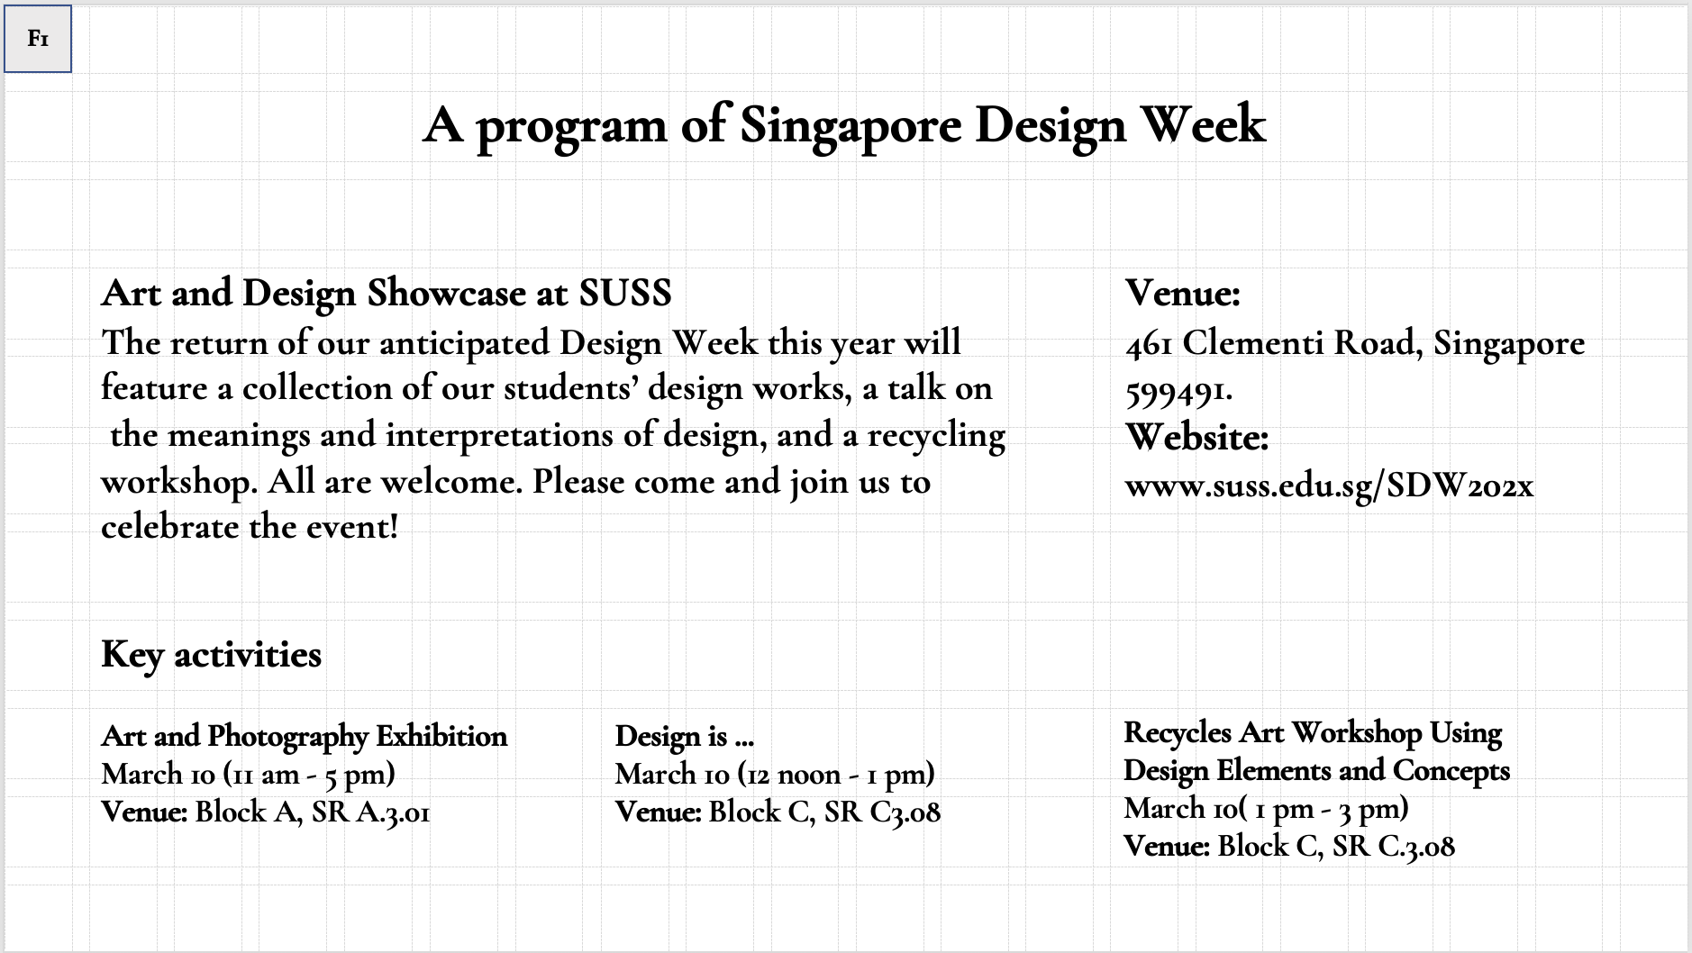
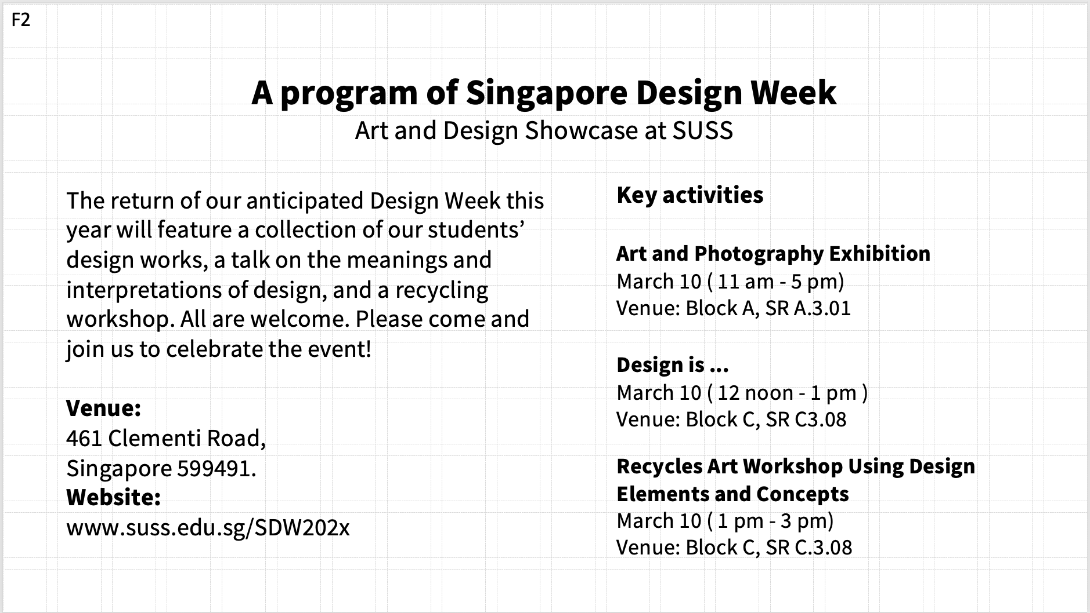
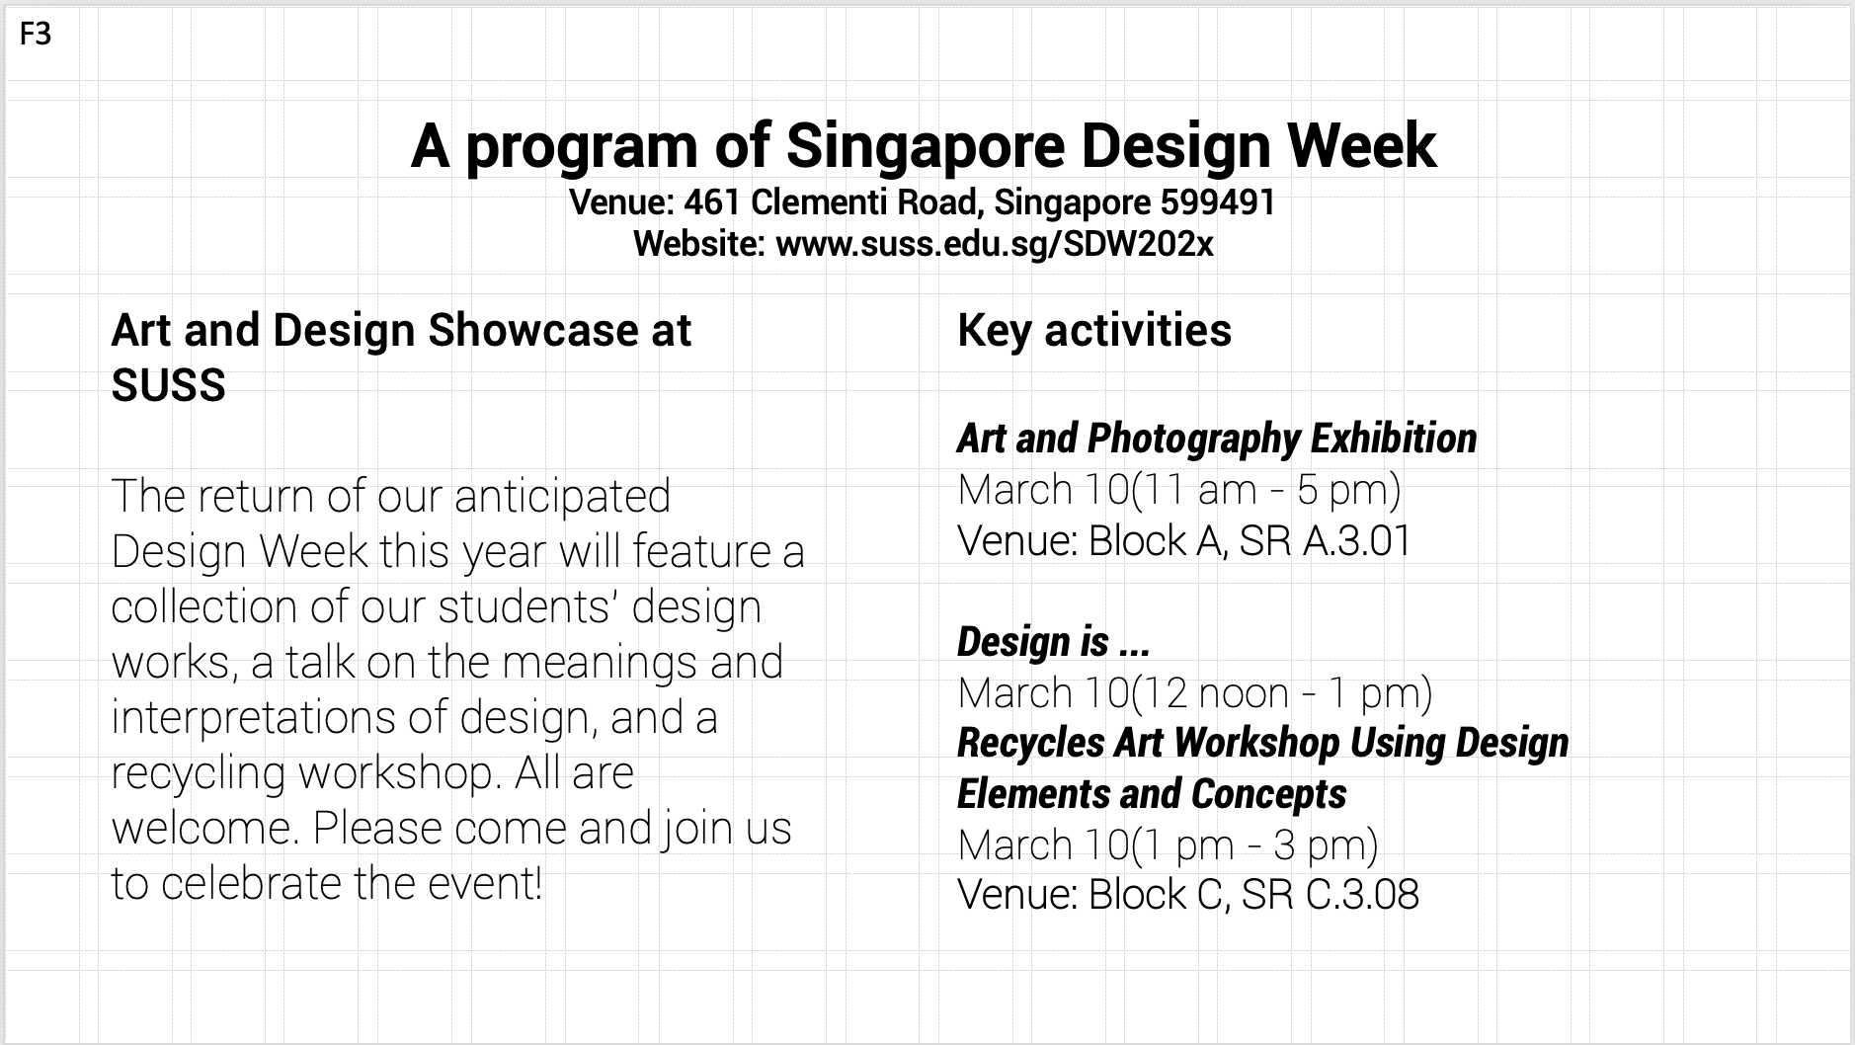
Original Sequence
Evaluated Sequence

Slide 22
Evaluation
After examining the designs, I've concluded that Design 2 is the most readable and aesthetically pleasing. The information is organized and presented in a way that makes it simple to read and understand. Design 3 was likewise effective in my opinion, albeit marginally less so than Design 2. On the other side, Design 1's disorganized layout, which can be challenging to traverse and understand, led me to rank it as the least effective design. Overall, Design 2 is the most successful because all the crucial details are immediately distinguishable and accessible.

Slide 23
Reflection

Slide 24
1a) I first thought the course "DES520-Communication Design for Business" would be simple and easy, therefore I registered in it. Yet after attending the first lecture, I quickly understood that the course was harder than I had first thought. I discovered that, despite being a risk analyst with experience giving presentations, the course necessitates a thorough comprehension and implementation of numerous design elements. During this course, I have developed a deeper understanding of basic design principles including grid systems, typefaces, fonts, and the Rule of 3 as well as how to use them in the real world to make persuasive presentation decks.I have to create three presentation layouts for this TMA that take into account different typographic variables and abide by certain criteria, such using a constrained color scheme. In addition to designing the layouts, I also have to justify each design and determine which, given the constraints, is the most successful.
1b) As a result of this TMA, I have come to understand the substantial influence that typographic factors have on a document's overall appearance and efficacy. I've come to realize how important it is to experiment with many typographic alternatives in order to find the best layout. Together with the significance of typographic variables, I have come to understand how important design principles are to a project's overall success. My ability to make presentation decks that are more effective and aesthetically pleasing has increased as a result of my deepening understanding of design principles like grid systems and callouts. Also, this Experience has reaffirmed how crucial teamwork is to getting results.
1c) The significance of effectively putting different design principles into practice is one of the most important lessons learned from this TMA. It has become obvious to me that properly implementing design principles like

Slide 25
grid systems and typography, can significantly improve a document's readability and aesthetic attractiveness.
Considering this experience, I think a team-based approach would have been especially helpful. It is easier to obtain a more thorough grasp of design concepts and their practical implementation when working cooperatively with others who bring different viewpoints and experiences. We may produce designs that are effective and visually appealing through this kind of teamwork, leading to a greater comprehension and appreciation of these ideas.
2a) At first, I thought the TMA would be simple and manageable because I had prior knowledge of the typographic variables we had discussed in class. But as soon as I started the assignment, I realized it was quite difficult and would take a lot of time and work to apply all of the necessary criteria correctly. The assignment should have been a group project, in my opinion, to allow for collaborative efforts and a more effective use of resources.
2b) While the majority of us are learning about these design concepts for the first time and are likely finding them difficult to comprehend and effectively apply, I believe that many of my classmates feel the same way.
3a) Learning and using new design principles, particularly typographic variables, which I will need for future jobs, was a benefit. The drawback is that it required a lot of time and was difficult because there was no peer collaboration.

Slide 26
3b) The ability to learn and apply new design concepts through the TMA was a success, but the lack of peer participation and discussion that would have made the assignment more manageable and effective was a failure. It was challenging to talk about and exchange ideas without a team, which might have ultimately resulted in better design solutions. In addition, the absence of teamwork made it more difficult to combine the workload with other obligations and academics. The task, in my opinion, would have been more successful if it had been a group effort.
4a) The job was more challenging and time-consuming than it would have been without the TMA's lack of collaboration. Without the assistance and involvement of a team, it was more challenging to balance the workload and discuss ideas, which may have led to better design solutions. Furthermore, it was more challenging to successfully apply the design concepts and typographic factors discussed in class without the chance to work with others.
4b)According to the literature, collaborative learning can be very effective in graphic design education. Collaboration is a key component of the collaborative learning process, which participants engage in to achieve a shared goal. Since it allows students to exchange ideas, benefit from one another's knowledge, and work together to solve design challenges, this type of training can be particularly beneficial in the teaching of design. Students who work together can gain a deeper understanding of typographic elements and design principles while also obtaining enlightening feedback from their peers. Working in teams allows students to gain crucial information about communication, project management, and conflict resolution—all skills necessary for

Slide 27
employment in design or any other industry. Working as a team on the TMA might have made it simpler to divide the effort and discuss ideas, which would have led to better design solutions and a more effective use of time.
(Tjetjep Rohendi Rohidi, 2009)
5a) If given the chance, I would decide to work on the project as a group so that we may all learn from one another and gather experience that will be helpful. The best design imaginable could be created by group collaboration and incorporating many points of view. It would also allow us to make the most of the training by combining our knowledge and sharing our unique skill sets.
5b) In order to promote effective group collaboration, I can create an atmosphere where everyone is valued and respected. Leading brainstorming sessions and encouraging open communication among group members helps achieve this. By promoting open communication, everyone will have the opportunity to contribute to the project, and we can all work together to find the best design solution.

Slide 28
References

Slide 29
Tjetjep Rohendi Rohidi, M. N. (2009). The InternationalJOURNALofthe HUMANITIES.
Retrieved from Collaborative Learning in Graphic DesignEducation:
https://www.researchgate.net/publication/307761677_Collaborative_Learning_in_Graphic_Design_Education

